Slide 1
University of Illinois REU Introduction to Matlab Day II
Compiled by Erik Huemiller

Slide 2
Goals for Today
Start with
Familiarity using the Matlab interface
Be able to create variables, write and run .m files
Make graphs with code and the GUI
End with
Ability to import data
Plot 2 graphs on the same plot
Fit the data to a function

Slide 3
Resources if you get stuck
Matlab Documentation
Easiest to find through a Google search of “Matlab + command”
There is example code with an explanation of most commands
Links to similar commands are listed at the bottom of the page
BYU Intro to Matlab
Loosely used as an outline for this crash course
PDF with less explicit cross references than the online material
Weitzman Institute
PDF and PPT lectures with slides and example code
Slow moving course designed for people that have never coded before.
Email grad student mentor with questions
Slower response, but can give individual feedback
Can meet up in person to work through a tough problem
Easiest way to find answers about syntax problems or unknown errors

Slide 4
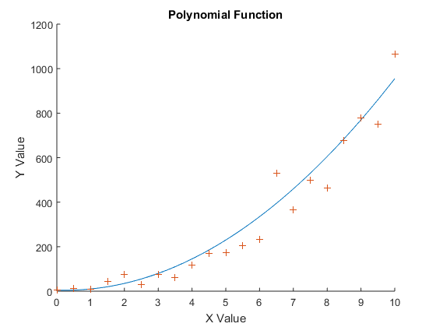
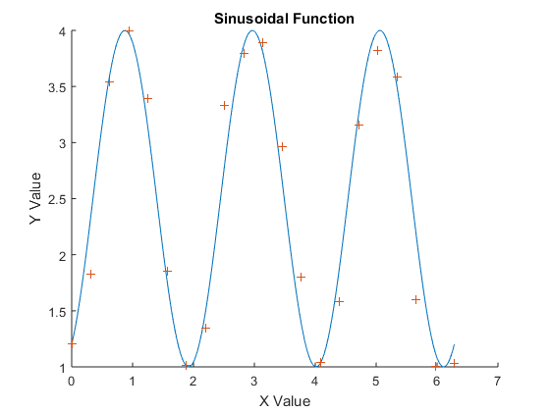
Creating some test Data
Before we get too far into plotting and fitting, we want to have some test data to play around with.
Try to write a program that will create some test data for us to fit functions to. Have 2 sets of data for each function, a low sample rate set with random noise and a high sample rate set to compare the noisy one to. Then plot both of the data sets for each function on the same graph to check that they infact overlap.
Function Types
Polynomial Function
3 periods of a sine function.
You are encouraged to use the commands from yesterday (creating variables, vector manipulation, for loops) to create the data set.

Slide 5
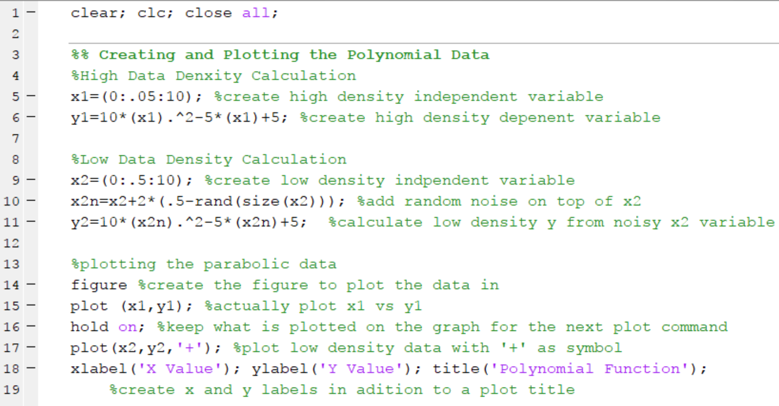
This is what mine looks like Polynomial Function

Slide 6
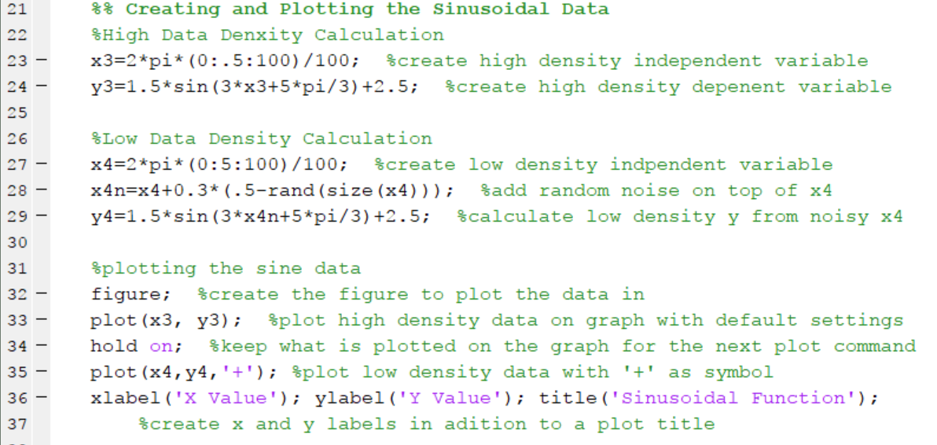
This is what mine looks like Sinusoidal Function

Slide 7
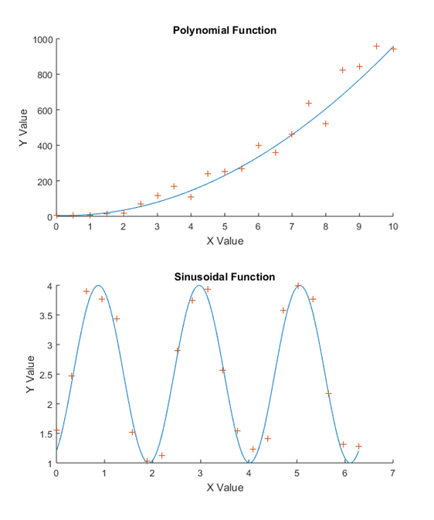
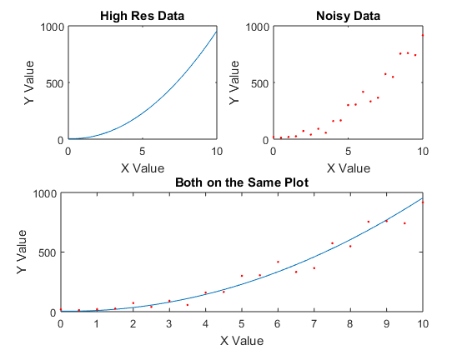
Sub Plots in Figures
In Matlab you can make one figure with multiple plots on it using the subplot command.
There are 3 parts to the command
The Number of columns of graphs
The Number of Rows of graphs
The position you want the next plot command to access
Example Code
figure ;
subplot ( A , B , C ) ;
plot ( x1 , y1 , ’ . ’ ) ;
Try to replicate the graphs on the right using the test data you generated earlier today and the subplot command.

Slide 8
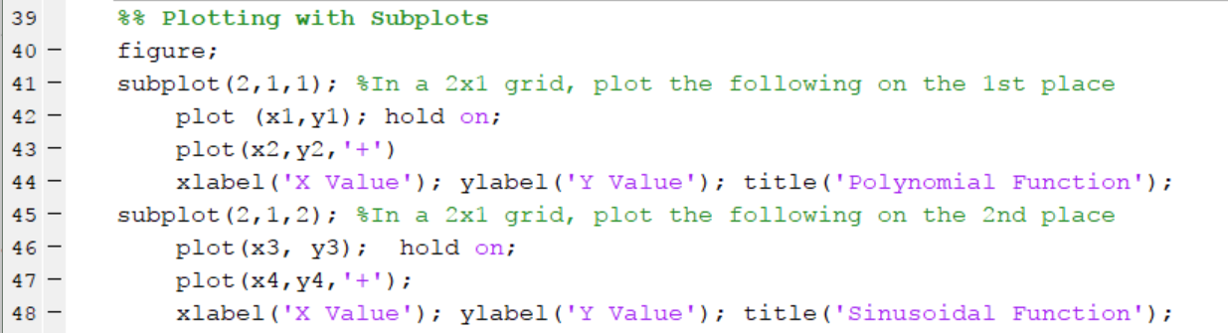
This is what mine looks like Utilizing Sub Plots to make Figures

Slide 9
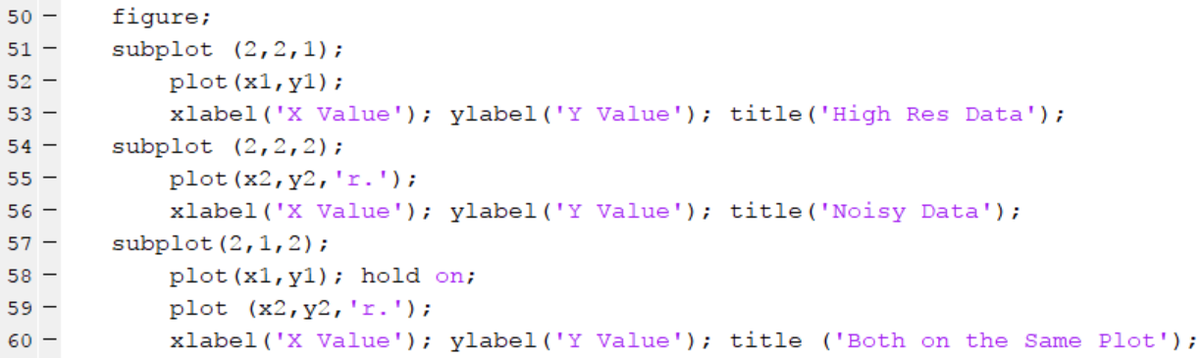
This is what mine looks like 3 Graphs with different geometries in a sub plot

Slide 10
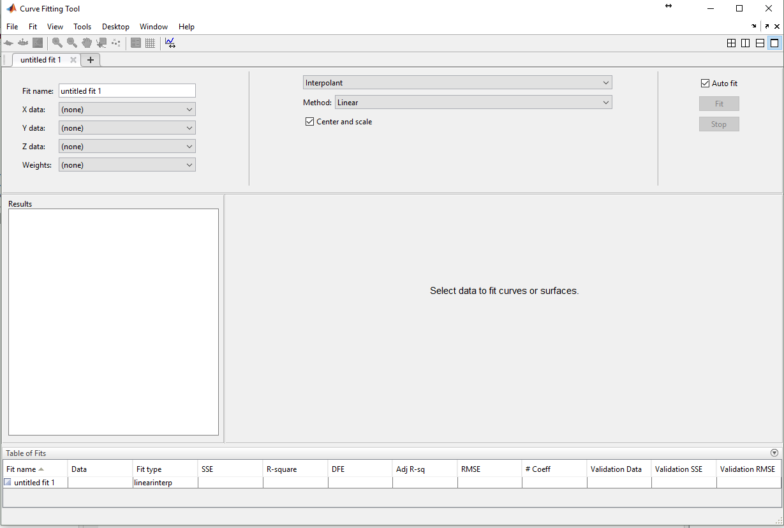
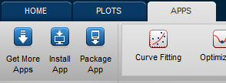
Fitting data to a Function
Try setting up a fit to the test data you generated
Using Code
Using the GUI
Fit type
Variables to fit

Slide 11
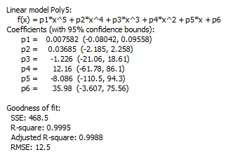
Analyzing the Fit
The Fitting App gives a quality of fit
Try adding more and more random noise to your data and see what happens to the different goodness of fit parameters.

Slide 12
Importing Data
Using Code – Matlab has support for importing a large variety of different file formats (see here). For today we will stick to using csv files (csvread and csvwrite commands).
Like we did yesterday, if you have the data file downloaded you can drag and drop it into the workspace to import the data.
Try downloading the sample functions in the Github folder and figure out what the functions are. If there is extra time, download the Boston marathon Data, and try fitting the outcomes to different functions (histograms to Gaussians etc)

